Slide 1
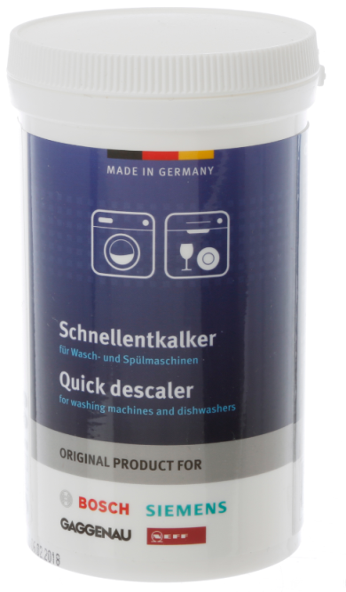





    Quick descaler for washing machines and dishwashers
    Article No.: 00311918
    Content: 250 g, sufficient for 1 application
Laundry Care
Dish Care
WEST
  Product features
    Quick and reliable removal of limescale in the entire interior of the appliance
    Decalcified heaters reduce heating time and power consumption
    Easy to use. One container equals one dose
    Can improve the lifetime and performance of the appliance
    Tested and approved for our appliances
    Made in Germany
  Application
  For washing machines and dishwashers.
  To effectively remove harmful limescale deposits from your appliance.
  Frequency of use: Washing machines every 3-6 months and dishwashers once a year.
  Please always refer to the instruction manual or display tip.
  Instruction
  Washing machines: Do not use with enamelled surfaces. Add the contents of the container (without laundry and detergent) into the washing machine and run the 60°C coloured laundry programme without pre-wash.
  Dishwashers: Do not use together with automatic dishwashing detergents. Switch on the empty dishwasher at the highest possible temperature. Open the dishwasher carefully after 30 minutes and add the contents of the container. Then run the program again for thorough cleaning. Exception: If a Machine Care program is available (refer to appliance instruction manual), please select this setting and add the descaler before the start of the program.
  Chemical regulatory information
  UFI Code: DMP0-V9YU-H008-UJA7 (for EU countries).
  Contents according to Regulation (EC) No. 648/2004: < 5% non-ionic surfactants. Contains: maleic acid.
  SDS according to Regulation (EC) No. 1907/2006 (REACH) with its amendment Regulation (EU) 2015/830.
  List of all ingredients referred to Detergents Regulation 648/2004/EC under
  www.pms-thomin.de/verzeichnis_inhaltsstoffe/
  Logistic details
  Packaging type: Plastic container
  Packaging dimension (L x W x H, cm): 6.5 x 6.8 x 11.7
  Packaging unit: 250 g/pack unit
  EAN: 4242005082773
  Dangerous good: No
  Languages: de, en, bg, es, fr, hr, it, nl, pt, sr
PCS-MAA, Edition 27.09.2021, Blanca Espona. Subject to change without notice. Despite careful review, the possibility of mistakes cannot be excluded. No guarantee will be provided.
Manufacturer’s Domestic Appliance Service
Pages: 1/2
PRODUCT DATA SHEET

Slide 2
Laundry Care
    Quick descaler
    for washing machines and dishwashers
    Article No.: 00311918
    Content: 250 g, sufficient for 1 application
Dish Care
WEST
  Previous products Art.-No.:
  00311506, 00311133
Alternative product Art.-No.:
  Value 4-pack: 00311922
  Additional products Art.-No.:
  Dishwasher cleaner: 00312193
  Dishwasher cleaner 4-pack: 00312257
  Dishwasher care: 00311993
  Dishwasher care 4-pack: 00311996
  Washing machine cleaner: 00311925
  Washing machine cleaner 4-pack: 00311928
  Supplier
  BSH Hausgeräte GmbH
  Carl-Wery-Str.34
  D-81739 München
Manufacturer
PMS Thomin GmbH
Meckesheimer Str. 7/1
D-74939 Zuzenhausen
  FAQ
  How often do I need to descale my washing machine?
  To ensure that your appliance operates perfectly, it is recommended that it is used every 3-6 month. The descaler is essential in hard water areas. Washing machines should additionally undergo a regular 90°C maintenance wash to avoid limescale and odours.
  2. How often do I need to descale my dishwasher?
  The descaler should be used if the dishwasher is badly scaled. This should not happen if salt or All-in-one tablets are used as advised in the manual, but it´s recommended to use the Quick descaler once a year.
  3. Do I need to descale if I´m using Calgon tablets in my washing machine?
  Scaling varies depending on a number of factors, such as water hardness, how you use the machine and what type of detergent you use. However, if you live in hard water area we recommend to use our Quick descaler .
  Marketing concept
  Target Group
  All owners of washing machines and dishwashers.
  Insight
  I would like to descale my appliance as simply and effectively as possible.
  Benefit
  Through the use of the Quick descaler, limescale deposits are being removed easily, quickly and thoroughly. Removal of limescale from the appliance and the heating elements also supports a faster heating time and thus lower power consumption.
  The use of our Quick descaler can prolong the lifetime of the appliance. Easy to dose and simply applicable.
  R2B
  The original Quick descaler is ideally suited for our appliances
  The application is particularly gentle thanks to the special formulation and optimal dissolution time. Furthermore, it is pre-packed in an ideal dosage for the device and thus ensures easy, thorough cleaning.
PCS-MAA, Edition 27.09.2021, Blanca Espona. Subject to change without notice. Despite careful review, the possibility of mistakes cannot be excluded. No guarantee will be provided.
Manufacturer’s Domestic Appliance Service
Pages: 2/2
PRODUCT DATA SHEET

