Slide 1
DFM Report
Picture of the part:

Slide 2
1.1 Project & DFM Information
Basic Part Data
Language: Preferred language to fill in the DFM Report is English. Usage of other language is applicable if upfront agreed with BSH |  |  |  |  |  |  |  |  | EN
End Customer |  |  |  |  |  | Mould BSH Serial No
Project Name |  |  |  |  |  | Planned Machine (T)
Part Name |  |  |  |  |  | Cavities
Part material |  |  |  |  |  | Part CQP Clasification [ A, B, C ]
CAD No. / Rev.-Status |  |  |  |  |  | Submission Date
Contact (s) | Part
 | Tool
 | Project
Mould Maker Data
Customer (if not BSH) |  |  |  |  | Basic Tool Dimensions (BHT)
Mould Maker |  |  |  |  | Injection system
Mould Designer (contact1) |  |  |  |  |  |  | Injection Moulding Machine Clamping Force [kN]
Other Contact (s) |  |  |  |  |  |  | Shot volume with sprue [cm³] (Foreseen value)
DFM Report Responsible (contact2) |  |  |  |  |  |  | Submission Date (Date of last revision sent to BSH)

Slide 3
1.2 Table of contents
 | Chapter | Topic | Requested |  | Done and Confirmed
 |  |  | For Quotation | After Tool Order | Supplier Finished ^{B} | Datum OK Customer Confirmed ^{A}
1. Project | 1.1 | Project & DFM Information |  | 
 | 1.2 | Table of contents |  | 
2. Product Info | 2.1 | Part and tool basic data |  | 
 | 2.2 | Mould cavity Layout |  | 
 | 2.3 | Gate Location and Type PROPOSAL |  | 
3. Parting Lines | 3.1 | Cavity & Core main parting lines definition |  | 
 | 3.2 | Slider & Lifter core Location and parting line definition |  | 
 | 3.3 | Ejector pin Location Proposal |  | 
 | 3.4 | Venting of critical areas |  | 
4. Draft | 4.1 | Draft Analysis |  | 
5. Drawing Analysis (2D) | 5.1 | Analysis of Control Dimension, Tolerances, Surface finish,… |  | 
6. Cooling | 6.1 | Cooling Channel Proposal & cooling of cavity inserts and critical areas | For Quotation not Requested | 
7. Improvement proposals | 7.1 | Product / Mould Improvement Proposals |  | 
8. Product Engrave | 8.1 | Cavity No. typ, size and Location |  | 
 | 8.2 | / |  | 
 | 8.3 | Adjustable model version sign typ, size and Location |  | 
9. Mold flow analysis | See separate table of contents
10. Remarks | 10 | Other remarks |  | 
*CRITERIA: (CQP Classification A,B,C - see BSH data on pg.1)
For A parts: → Necessary
For B and C parts: → If without cooling process part warps more than are allowable tolerances on drawing then COOL-analysis HAS TO BE PERFORMED
A … filled in by BSH
B … filled in by supplier

Slide 4
2.1 Part and Tool basic data
Short description of Mold. ^{B}
Confirmation: | Tool can be used on 1st page planned moulding machine |  |  | Cavity Steel
Type of Gate |  |  |  | Core Steel
No. of Cavity |  |  |  | Slider Steel
No. of Injection Points |  |  |  | Lifter Steel
Estimate Part Weight (g) |  |  |  | Coating of cores and cavities
Mold Shrinkage |  |  |  | Resin (Color Additiv)
 |  |  |  | Estimated Runner Weight (g)
2.2 MOULD CAVITY LAYOUT
(sketch can be used here)
On injection moulding tool concept show:
number of cavities;
layout of cavity inserts;
tool orientation on the moulding machine. Mark upper (Top) side of tool.
BSH Decision/Comments
OK / NOK Name, dd.mm.yy

Slide 5
2.3 Gate location and Type Proposal
Describe and show:
sprue type;
position of sprue-point;
size of sprue-point;
impact of sprue-point on part geometry (calotte, etc.);
in case of more complex injection system, calculation of pressure-drop through cavity and hot-runner system must be performed. (For TOOL ORDER ONLY!);
dimension`s of cold runner system (see picture below) (For TOOL ORDER ONLY!).
BSH Decision/Comments
OK / NOK Name, dd.mm.yy

Slide 6
3.1 Cavity & Core main parting lines definition
Describe and show:
main parting lines
BSH Decision/Comments
OK / NOK Name, dd.mm.yy

Slide 7
3.2 Slider & Lifter cores Location and parting line definition
Describe and show:
all slider parting lines;
show lifters and moving directions.
BSH Decision/Comments
OK / NOK Name, dd.mm.yy

Slide 8
3.3 Ejector pin Location Proposal
Describe and show:
show position and marks of ejectors and protection of ejectors under side cores
Important: If ejectors are below side cores, they must be mechanical protected and this principle must be shown here.
BSH Decision/Comments
OK / NOK Name, dd.mm.yy

Slide 9
3.4 Venting of critical areas:
(for Quotation sketch can be used here)
Show the way of venting critical areas regarding to:
part geometry;
analysis of air traps presence;
filling analysis.
BSH Decision/Comments
OK / NOK Name, dd.mm.yy

Slide 10
4.1 Draft analysis
Show influence of drafting angles on:
shape, surface structure and for demolding;
give potential recommendations for modification of drafting angles on part.
BSH Decision/Comments
OK / NOK Name, dd.mm.yy

Slide 11
5.1 Analysis of Control Dimension, Tolerances, Surface finish,…
If proposal for drawing change exist it must be clarified and confirmed here.
Check 2D drawing characteristics and specially:
control dimension analysis;
tolerance analysis;
how to reach the requirements?
changeable inserts / separate inserts?!?
surface finish analysis.
BSH Decision/Comments
OK / NOK Name, dd.mm.yy

Slide 12
6.1 Cooling Channel Proposal & cooling of cavity inserts and critical areas
Show implementation of:
cooling;
cavity inserts (injection side & ejection side);
critical areas (baffle plates, spiral core, etc.);
cooling of hot-runner system;
tool housing;
dimension of the cooling system (e.g. diameter, distance, etc. ).
BSH Decision/Comments
OK / NOK Name, dd.mm.yy

Slide 13
7.1 Improvement Proposals
Describe and show proposals e.g.:
undercut Improvement Proposal;
mould Improvement Proposal;
cavity & Core Draft Angle Improvement Proposal;
slider & Lifter Draft Angle Improvement Proposal.
Undercut Improvement Proposal 1
BSH Decision/Comments
OK / NOK Name, dd.mm.yy

Slide 14
8 Product Engrave, Sign type size and location
Confirmation whether proposed place for signs is suitable regarding injection moulding-tool concept. If not, here show proposal for other location.
Check 2D drawing demands:
8.1 cavity no. type, size and location
8.2 adjustable date sign type, size and location
8.3 adjustable model version sign type, size and location
BSH Decision/Comments
OK / NOK Name, dd.mm.yy

Slide 15
9 Mold flow analysis
Mold Flow Analysis Report should be a separate report,
prepared in detailed and professional manner. See points 9.1÷ 9.8
This file or files must be attached to this DFM Report.
9 Mold flow analysis:
9.1 Input data
9.1.1 mesh (parameter)
9.1.2 material, process parameter (mold, barrel, hot runner temperature, e.g.)
9.2 fill time
9.3 pressure drop
9.4 weld lines
9.5 air traps
9.6 sink marks
9.7 warping
9.8 cool FEM analysis
Restriction:
A mesh match percentage of 85% or higher is acceptable for a Dual Domain Fill+Pack analysis. A percentage of 50% or lower will cause the Fill+Pack analysis to abort. For a Dual Domain Warp analysis, the mesh match percentage should exceed 85%.
 | File name | Sent: Datum
DFM Report Attachment 1
DFM Report Attachment 2
DFM Report Attachment 3
DFM Report Attachment 4
BSH Decision/Comments
OK / NOK Name, dd.mm.yy

Slide 16
10 OTHER REMARKS ^{B}
Fill in other remarks or proposals that are important for achieving manufacturing process as foreseen with the requirements.
BSH Decision/Comments
OK / NOK Name, dd.mm.yy
IMPORTANT NOTE: If there are no remarks to the technical requirements or other related documentation submitted by BSH, it is assumed, that supplier confirms to achieve required product, tool and process specifications.

Slide 17
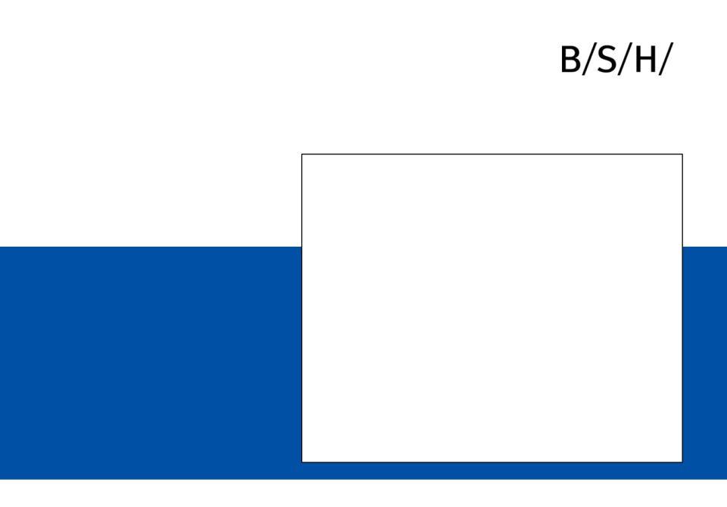
Storage location of actual version:
https://www.bsh-group.com/si/podjetje/globalna-nabavna-veriga/dokumenti
Rev. / Date
Moldflow Report
Part name
Picture of part:
BSH Hausgeräte GmbH / Product Division Consumer Products
MF Report (Version 08/2021) I Page: 17

Slide 18
Document History
Step A - BSH internal during development, only on the component (optional)
Step B - requested suppliers, on the component with simplified cooling and simplified gate
Step C - selected supplier together with DFM document before start of tool making, component with sprue and tool with concrete CAD tool design
(Step C may have to be repeated for larger tool changes)
Revision | Date | Created by | Modification Text
BSH Hausgeräte GmbH / Product Division Consumer Products
MF Report (Version 08/2021) I Page: 18

Slide 19
General Rules
Feasibility Commitment stay valid! also if results of Moldflow are out of tolerance → real part must arrive tolerances
Language of document is English
Naming of document is MF SAP Nr. – Revision – Part Name (example: MF 8001001515 – A1 – Sample Name)
Results have to be in SI-Units or typical units, different units after conforming by BSH possible
Instead of unit “bar” it is possible use unit “MPa” (change must be marked!)
Deformation and deviations have to be cleaned up of shrinkage/ excluded of shrinkage
Result pictures must have a readable scale with units
Variation of simulation must be clearly marked as variation
Input data stay the same for all results
If there is not enough space at one page, it is possible to copy template foil of this topic
STL-file of deformed part after total cooling (to 23 °C) is desirable
Animation (for example of part filling) can be separate video data otherwise they have to be implemented in Document as video
Pages which are marked as optional are not necessary , all other skipped foils must be justified (page remains available, reasons for not filling must be given on the foil)
Add material data sheet in presentation or attach it as separate document (pdf.)
All information which are attached as separate documents (animations, material data sheet, …) have to be named in presentation (example: see attached document “material data sheet super plastic.pdf”)
In final revision all pages with results and comments have to be implemented
Pictures and results on foils have to be commented (what does the picture say, evaluation of the result, prevention action)
Add special features (e.g. cooling inserts, cascade injection, ...) independently on additional foil if they are used
Possible conspicuous features are to be listed in detail by the supplier in extra transparencies
Several variants can be simulated, but one variant should be chosen (reason must be explain) and stay constant over simulation → still only one MF document
"Log-File" (automatically generated simulation protocol) as well as “.mfr file”, “.rsv file” or other result files are desirable
The responsibility for results and interpretation of results remains with the supplier
Each step (A, B, C) gets its own document, the individual versions of this document (e.g. A1, A2, A3 ...) are adapted in this one document and modifications are described at page "document history“
For two component parts the relevant pages must be copied independently
At the “template page for free design”, the design can be changed as desired (only on these pages)
Risk assessment should always be filled in, if there is no risk this should be the comment.
It is sufficient to fill in the comment fields of step B for submission of the offer. For example, if supplier can assess risk based on his experience without simulation.
BSH Hausgeräte GmbH / Product Division Consumer Products
MF Report (Version 08/2021) I Page: 19

Slide 20
Content
not necessary -
optional o
necessary +
as far as possible (+)
Title Page Step A Step B Step C
(BSH / optional) (requested supplier) (chosen supplier)
Result Overview 5 development quotation tool order
Summary of results 6 (+) + +
Summary of Optional Supplements 7 o o o
Virtual Measurements 8 - 9 o o +
General Information 10
General Information 11 (+) + +
Material Processing Parameters 12 + + +
Material data sheet or Material data set 13 + + +
pvT-Diagram 14 o + +
Filler information 15 (only if fillers are used) o + +
Simulation Results “Quotation 16
Wall thickness analyse 17 + + +
Injection System 18 only place simplified +
Cooling System 19 - (+) +
Fill Time animation 20 + + +
Weld Lines 21 + + +
Air Traps 22 o + +
Sink Marks 23 o + +
Shrinkage after cooling 24 (+) + +
Deformation after cooling (total) 25 + + +
Deformation after cooling (directional vector) 26 - 28 o (+) +
Simulation Results “Tool Order” 29
Pressure Distribution at switchover point 30 - o +
Pressure Analyses 31 - o +
Pressure at machine nozzle 32 - o +
Temperature Distribution 33 o o +
Fibre Orientation 34 (only if fibres are used) o o +
Optional Supplements 35
Variation of Injection System 36 (optional) o o o
Animation of the velocity vectors 37 (optional) o o o
Flow Front Temperature 38 (optional) o o o
Holding Pressure Distribution 39 (optional) o o o
Plastic Core Distribution during cooling 40 (optional) o o o
Plastic Range during cooling animation 41 (optional) o o o
Shear Rate 42 (optional) o o o
Mesh Quality 43 (optional) o o o
Reversible model 44 (optional) o o o
Suggestions of optimisations 45 (optional) o o o
Variation of material to arrive better results 46 (optional) o o o
Additional Results 47 (optional) o o o
BSH Hausgeräte GmbH / Product Division Consumer Products
MF Report (Version 08/2021) I Page: 20

Slide 21
Result Overview
always to be filled out
(virtual measurements only for Step C)
The chapter "Result Overview" must always be filled in with all results of current step. In Step C, all results of Step B must also be filled in.
The chapter "Result Overview" is a summary of all requested foils of chapter "Simulation Results" (Step B as well as Step C)
From Step C at the latest, all results must be based on a Moldflow (see optional simplification for Step B). Also in the case of simplification for Step B, the results table including risk assessment must be completed
The virtual measurement report is only required for Step C on.
BSH Hausgeräte GmbH / Product Division Consumer Products
MF Report (Version 08/2021) I Page: 21

Slide 22
Summary of results
 | No influence at part
 | Low risk
 | Medium risk
 | High risk
For medium and high risk, please note planed prevention action, risks (also if they are named) do not exempt from feasibility commitment and duty to arrive tolerances and requirements at real part.
Page / Information | supplier comment/ result | planed prevention action (if necessary) | rating
Step B and following
Wall thickness
Fill Time
Weld Lines
Air Traps
Sink Marks
Shrinkage
Warpage/ Deformation (Total)
Deformation (X-Direction)
Deformation (Y-Direction)
Deformation (Z-Direction)
Step C and following
Pressure Distribution
Pressure Analyses
Pressure at machine nozzle
Temperature Distribution
Plastic Core (optional)
Fibre Orientation (optional)
BSH remark
Comment Name / Date
BSH Hausgeräte GmbH / Product Division Consumer Products
MF Report (Version 08/2021) I Page: 22

Slide 23
Summary of Optional Supplements
for optional results only
 | No influence at part
 | Low risk
 | Medium risk
 | High risk
For medium and high risk, please note planed prevention action, risks (also if they are named) do not exempt from feasibility commitment and duty to arrive tolerances and requirements at real part.
Page / Information | supplier comment/ result | planed prevention action (if necessary) | rating
BSH remark
Comment Name / Date
BSH Hausgeräte GmbH / Product Division Consumer Products
MF Report (Version 08/2021) I Page: 23

Slide 24
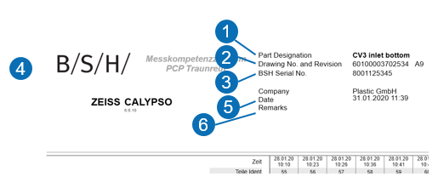
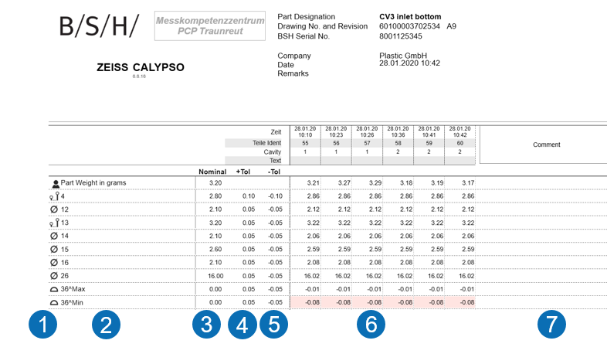
Virtual Measurements
Step C
Measurements at virtual final part (STL model of mould flow measured at measurement department) → model have to be cleaned up of shrinkage, positioning must be done according to reference system. For dimensions out of tolerance or close to tolerance limit (2/3 of tolerance range) prevention action have to be noted. Deviations of virtual measurements do not exempt from feasibility commitment and duty to arrive tolerances at real part.
Rules for automatic measurement report otherwise use BSH template of Sample inspection report:
In general: Document must be written in English, geometrical tolerances with reference have to noted with “min” and “max” value (see example picture 2).
Necessary information:
Head of document: example pictures:
1 part name
2 part number of BSH with revision
3 SAP code of BSH
4 supplier name
5 date
6 place for comments
Measurements:
1 symbol of indication (optional)
2 BCT number of drawing
3 nominal value
4 upper tolerance
5 lower tolerance
6 measurement value, values out of tolerance must be red marked
(if more variations are measured, each variation in one column)
(For FFOT samples, three parts per cavity must be measured, each
with its own column → see SIR document)
7 place for comments (for example: prevention action )
BSH Hausgeräte GmbH / Product Division Consumer Products
MF Report (Version 08/2021) I Page: 24

Slide 25
Virtual Measurements
Step C
Expected measurements at final part → cleaned up of shrinkage.
BSH remark
Comment Name / Date
BSH Hausgeräte GmbH / Product Division Consumer Products
MF Report (Version 08/2021) I Page: 25

Slide 26
General information
always to be filled out
Input values of the simulation / basis data of the Moldflow
In the special case "Fill in on the basis of experience" (see results of Step B/ Status Quotation), the fields are to be filled in as far as possible.
The material data / material parameters of the material used for simulation must be entered in this document. If this material differs from the one indicated on the drawing, a justification must be given.
BSH Hausgeräte GmbH / Product Division Consumer Products
MF Report (Version 08/2021) I Page: 26

Slide 27
General Information
* only for 2K-Parts
** only for Step C
Screenshots of the input mask for Basic data of simulation is sufficient if all information are readable.
If a replacement material is used, a justification for the chosen material shall be given.
Part
Part name |  |  |  |  |  |  |  |  | CQP Classification
Drawing Nr & Revision |  |  |  |  |  |  |  |  | SAP Code
Supplier
address |  |  |  |  |  |  |  |  | Moldflow done by (insofar as supplier does not make Moldflow at there own)
contact |  |  |  |  |  |  |  |  | Moldflow software & version
Basic data of simulation
Planned machine |  |  |  |  |  |  |  |  | Clamping force [KN]
Number of cavities |  |  |  |  |  |  |  |  | Injection pressure [bar]
Material component 1 |  |  |  |  |  |  |  |  | Volume injection unit 1 [cm³]
Material component 2 * |  |  |  |  |  |  |  |  | Volume injection unit 2 [cm³] *
Tool temperature during filling |  |  |  |  |  |  |  |  | Mesh size
Tool temperature during cooling |  |  |  |  |  |  |  |  | Mesh quality
Middle plane |  | shell body (DD) |  |  |  | 3D mesh |  |  | Number of mesh elements (part)
Cooling BEM |  |  |  | Cooling FEM |  |  |  |  | Number of mesh elements (mold) **
BSH Hausgeräte GmbH / Product Division Consumer Products
MF Report (Version 08/2021) I Page: 27

Slide 28
Material Processing Parameters
Screenshots of the input mask are sufficient if all information are readable.
If a replacement material is used, a justification for the chosen material shall be given.
* optional, if possible please specify
Material Description & Material Database
Material Name |  |  |  |  |  |  |  |  |  |  | Material Family
Test Date * |  | Last Modification * |  |  |  |  |  |  |  |  | Material Structure
Material Data Completeness Indicator * |  | Gold |  |  | Silver |  |  | Bronze |  |  | Fillers
Processing Parameters
Mold Temperature [°C] |  |  |  |  |  |  |  |  |  |  | Maximum Shear Stress [N/mm²]
Mold Temperature range [°C] |  | min. |  |  |  |  | max. |  |  |  | Maximum Shear Rate [1/s]
Melt Temperature [°C] |  |  |  |  |  |  |  |  |  |  | Transition Temperature [°C]
Melt Temperature Range [°C] |  | min. |  |  |  |  | max. |  |  |  | Density Melt [g/cm³] |  | Density Solid [g/cm³]
Mechanical Properties
Elastic Modulus Parallel [N/mm²] |  |  |  |  |  |  |  |  |  |  | Thermal Expansion coefficient Parallel [1/°C]
Elastic Modulus Perpendicular [N/mm²] |  |  |  |  |  |  |  |  |  |  | Thermal Expansion coefficient Perpendicular [1/°C]
Poissons Ratio Parallel |  |  |  |  |  |  |  |  |  |  | Yield strain [%] *
Poissons Ratio Perpendicular |  |  |  |  |  |  |  |  |  |  | Breaking stress [N/mm²] *
Shrinkage
Observed Shrinkage Parallel [%] |  | min. |  |  |  |  | max. |  |  |  | Observed Nominal Shrinkage Parallel [%]
Observed Shrinkage Perpendicular [%] |  | min. |  |  |  |  | max. |  |  |  | Observed Nominal Shrinkage Perpendicular [%]
Replacement Material (only if correct material is not available for Moldflow)
Explanatory Comment
Used theoretical Models
Shrinkage model * |  |  |  |  |  |  |  |  |  |  | Fiber orientation model *
BSH Hausgeräte GmbH / Product Division Consumer Products
MF Report (Version 08/2021) I Page: 28

Slide 29
Material data sheet or Material data set
Placeholder for material data sheet if the template foil is not filled out
Material data sheet
BSH Hausgeräte GmbH / Product Division Consumer Products
MF Report (Version 08/2021) I Page: 29

Slide 30
pvT-Diagram
Estimated Part Weight [g] |  | Estimated Melt-Cushion-Volume [cm³]
Picture of pvT-diagram
BSH Hausgeräte GmbH / Product Division Consumer Products
MF Report (Version 08/2021) I Page: 30

Slide 31
Filler information
(only in case fillers are used)
data comparable to page “Material Processing Parameters”
Screenshot of input mask from Filler
BSH Hausgeräte GmbH / Product Division Consumer Products
MF Report (Version 08/2021) I Page: 31

Slide 32
Simulation Results
Step B and following (Status: “Quotation”)
Optional simplification for simple parts (option excluded for components with CQP-A level):
It is sufficient to fill in the comment fields of step B for submission of the offer. For example, if supplier can assess risk based on his experience without simulation. An independent comment on each point/ page is necessary. Comments must be clearly marked on which data basis (e.g. experience) they are basing.
Summary results table with estimated risk must be filled in completely, even if the pages are only filled with comments (without doing Moldflow simulation, based on experience).
This simplification is only valid for Step B (Status: “Quotation”), in Step C (Status: “Tool Order”) all required pages have to be filled in with Moldflow results, also the pages "Step B and following".
BSH Hausgeräte GmbH / Product Division Consumer Products
MF Report (Version 08/2021) I Page: 32

Slide 33
Wall thickness analyse
* Is the geometry meshed fine enough, represented well by the wall thickness distribution (radii, ribs, mesh accuracy, ...)
If more detailed descriptions are needed, these can be made on the mesh quality slide.
Minimal wall thickness [mm] |  |  | Maximal wall thickness [mm] |  | Geometry plausibility check *
Comment (influence for simulation and results)
Picture of Wall Thickness
BSH Hausgeräte GmbH / Product Division Consumer Products
MF Report (Version 08/2021) I Page: 33

Slide 34
Injection System
For Step B a simplified version is sufficient
Type of System |  | Dimension of gate [mm]
Number of gate points
Picture of position (and type of gate only from Step C on)
Picture of dimensions of gate (only Step C and following)
BSH Hausgeräte GmbH / Product Division Consumer Products
MF Report (Version 08/2021) I Page: 34

Slide 35
Cooling System
For Step B a simplified version is sufficient
* Range of result values
Cooling medium |  | Dimension of cooling [mm] *
Tool steel
Temperature [°C] *
Pressure [bar] *
Reynolds number *
Estimated temperature in cooling system
Estimated pressure in cooling system
Estimated fluid flow behaviour in cooling system
BSH Hausgeräte GmbH / Product Division Consumer Products
MF Report (Version 08/2021) I Page: 35

Slide 36
Fill Time Animation
In case of inaccuracies at the seal off point, please give more details at the foil “Plastic Core”
* Range of result values, details on page “plastic core”
Fill Time [s] |  |  | switchover point [s] [%]
Seal off time [s] (part* / gate) |  |  | Ejection time [s]
Comment / Risk
Animation of filling
BSH Hausgeräte GmbH / Product Division Consumer Products
MF Report (Version 08/2021) I Page: 36

Slide 37
Weld Lines
Temperature at time of contact [°C] |  | Pressure at time of contact [bar]
Time between weld line seam formation and start of packing pressure [s]
Risk assessment by the supplier (visually, strength problems, ...)
Picture of Weld Lines
BSH Hausgeräte GmbH / Product Division Consumer Products
MF Report (Version 08/2021) I Page: 37

Slide 38
Air Traps
Risk assessment and preventive actions:
Picture of Air Traps
BSH Hausgeräte GmbH / Product Division Consumer Products
MF Report (Version 08/2021) I Page: 38

Slide 39
Sink Marks
Maximal sink mark [mm] |  | Range of sink marks [mm]
Comment / Risk
Picture of Sink Marks (mark the most critical place)
BSH Hausgeräte GmbH / Product Division Consumer Products
MF Report (Version 08/2021) I Page: 39

Slide 40
Shrinkage after cooling
Averaged volume shrinkage // Areas with shrinkage of 10 % or more must be clearly marked
Minimal shrinkage [%] |  | Cooling time [s]
Maximal shrinkage [%] |  | Comment/ Risk
Picture of Shrinkage
BSH Hausgeräte GmbH / Product Division Consumer Products
MF Report (Version 08/2021) I Page: 40

Slide 41
Deformation after cooling (total)
Warpage, cleaned up of shrinkage/ excluded of shrinkage → at final part
Maximal deformation [mm] |  | Cooling time [s]
Shrinkage compensation factor [%] |  | Part temperature | 23 °C
Comment / Risk
Picture of Deformation
BSH Hausgeräte GmbH / Product Division Consumer Products
MF Report (Version 08/2021) I Page: 41

Slide 42
X-Deformation after cooling
cleaned up of shrinkage/ excluded of shrinkage → at final part
Maximal deformation [mm] |  | Cooling time [s]
Shrinkage compensation factor [%] |  | Part temperature | 23 °C
Comment / Risk
Picture of Deformation with coordinate system
BSH Hausgeräte GmbH / Product Division Consumer Products
MF Report (Version 08/2021) I Page: 42

Slide 43
Y-Deformation after cooling
cleaned up of shrinkage/ excluded of shrinkage → at final part
Maximal deformation [mm] |  | Cooling time [s]
Shrinkage compensation factor [%] |  | Part temperature | 23 °C
Comment / Risk
Picture of Deformation with coordinate system
BSH Hausgeräte GmbH / Product Division Consumer Products
MF Report (Version 08/2021) I Page: 43

Slide 44
Z-Deformation after cooling
cleaned up of shrinkage/ excluded of shrinkage → at final part
Maximal deformation [mm] |  | Cooling time [s]
Shrinkage compensation factor [%] |  | Part temperature | 23 °C
Comment / Risk
Picture of Deformation with coordinate system
BSH Hausgeräte GmbH / Product Division Consumer Products
MF Report (Version 08/2021) I Page: 44

Slide 45
Simulation Results
Step C (Status: “Tool Order”)
BSH Hausgeräte GmbH / Product Division Consumer Products
MF Report (Version 08/2021) I Page: 45

Slide 46
Pressure Distribution at switchover point
switchover point [%] |  | Range of pressure at switchover point [bar]
Comment / Risk
Picture of pressure Distribution
BSH Hausgeräte GmbH / Product Division Consumer Products
MF Report (Version 08/2021) I Page: 46

Slide 47
Pressure Analyses
Statement
Maximal pressure [bar]
Maximal pressure [bar]
Maximal pressure [bar]
Picture of pressure only at part
Picture of pressure at part and cold runner
Picture of pressure at part, cold runner and hot runner
BSH Hausgeräte GmbH / Product Division Consumer Products
MF Report (Version 08/2021) I Page: 47

Slide 48
Pressure at machine nozzle
Diagram of pressure at machine over time
Maximal pressure [bar]
Level of packing pressure [bar]
Time till packing pressure [s]
Time of packing pressure [s]
Maximal clamp force [KN]
Machine size [KN]
Comment
Diagram of clamp force over time
BSH Hausgeräte GmbH / Product Division Consumer Products
MF Report (Version 08/2021) I Page: 48

Slide 49
Temperature Distribution
Averaged component temperature at end of cycle
Minimal temperature [°C] |  | Maximal temperature [°C]
Comment / Risk
Picture of Temperature Distribution
BSH Hausgeräte GmbH / Product Division Consumer Products
MF Report (Version 08/2021) I Page: 49

Slide 50
Fibre Orientation
(only in case fillers are used)
Orientation of fibres
BSH Hausgeräte GmbH / Product Division Consumer Products
MF Report (Version 08/2021) I Page: 50

Slide 51
Optional Supplements
Optional independent of step
optional
BSH Hausgeräte GmbH / Product Division Consumer Products
MF Report (Version 08/2021) I Page: 51

Slide 52
Variation of Injection System
Reason for chosen injection system
Chosen concept
Variation 1
Variation 2 …
BSH Hausgeräte GmbH / Product Division Consumer Products
MF Report (Version 08/2021) I Page: 52

Slide 53
Animation of the velocity vectors
only if there are abnormalities
Animation of the velocity vectors
BSH Hausgeräte GmbH / Product Division Consumer Products
MF Report (Version 08/2021) I Page: 53

Slide 54
Flow Front Temperature
Minimal flow front temperature [°C] |  | Maximal flow front temperature [°C]
Maximal temperature decrease [°C] |  | Maximal temperature increase [°C]
Comment / Risk
Picture of Flow Front Temperature
BSH Hausgeräte GmbH / Product Division Consumer Products
MF Report (Version 08/2021) I Page: 54

Slide 55
Holding Pressure Distribution
Minimal pressure [bar] |  | Maximal pressure [bar]
Packing pressure [bar] |  | Packing pressure time [s]
Comment / Risk
Picture of Holding Pressure Distribution
BSH Hausgeräte GmbH / Product Division Consumer Products
MF Report (Version 08/2021) I Page: 55

Slide 56
Plastic Core Distribution during cooling
Maximal temperature at ejection [°C] |  | Cooling time till ejection [s]
Comment / Risk
Picture of Plastic Core Distribution
BSH Hausgeräte GmbH / Product Division Consumer Products
MF Report (Version 08/2021) I Page: 56

Slide 57
Plastic Core during cooling animation
Animation of Plastic Range
BSH Hausgeräte GmbH / Product Division Consumer Products
MF Report (Version 08/2021) I Page: 57

Slide 58
Shear Rate / Temperature
Maximal shear rate [1/s] |  | Max temperature [°C]
Comment / Risk
Area of max. Shear Rate
Area of max. Temperature
BSH Hausgeräte GmbH / Product Division Consumer Products
MF Report (Version 08/2021) I Page: 58

Slide 59
Mesh Quality
Maximal element size [mm] |  | Minimal element size [mm] |  | Average element size [mm]
Comment
Picture of Mesh elements at Part
BSH Hausgeräte GmbH / Product Division Consumer Products
MF Report (Version 08/2021) I Page: 59

Slide 60
Reversible model
Reversible model
BSH Hausgeräte GmbH / Product Division Consumer Products
MF Report (Version 08/2021) I Page: 60

Slide 61
Suggestions of optimisations
Template page for free design to present suggestions
BSH remark
Comment Name / Date
BSH Hausgeräte GmbH / Product Division Consumer Products
MF Report (Version 08/2021) I Page: 61

Slide 62
Variation of material to arrive better results
Template page for free design to present suggestions
BSH remark
Comment Name / Date
BSH Hausgeräte GmbH / Product Division Consumer Products
MF Report (Version 08/2021) I Page: 62

Slide 63
Additional Results
Template page for free design
Place for results that supplier usually considers, but which are not required and therefore have no separate template page.
Please enter a descriptive comment
BSH Hausgeräte GmbH / Product Division Consumer Products
MF Report (Version 08/2021) I Page: 63

